Slide 1
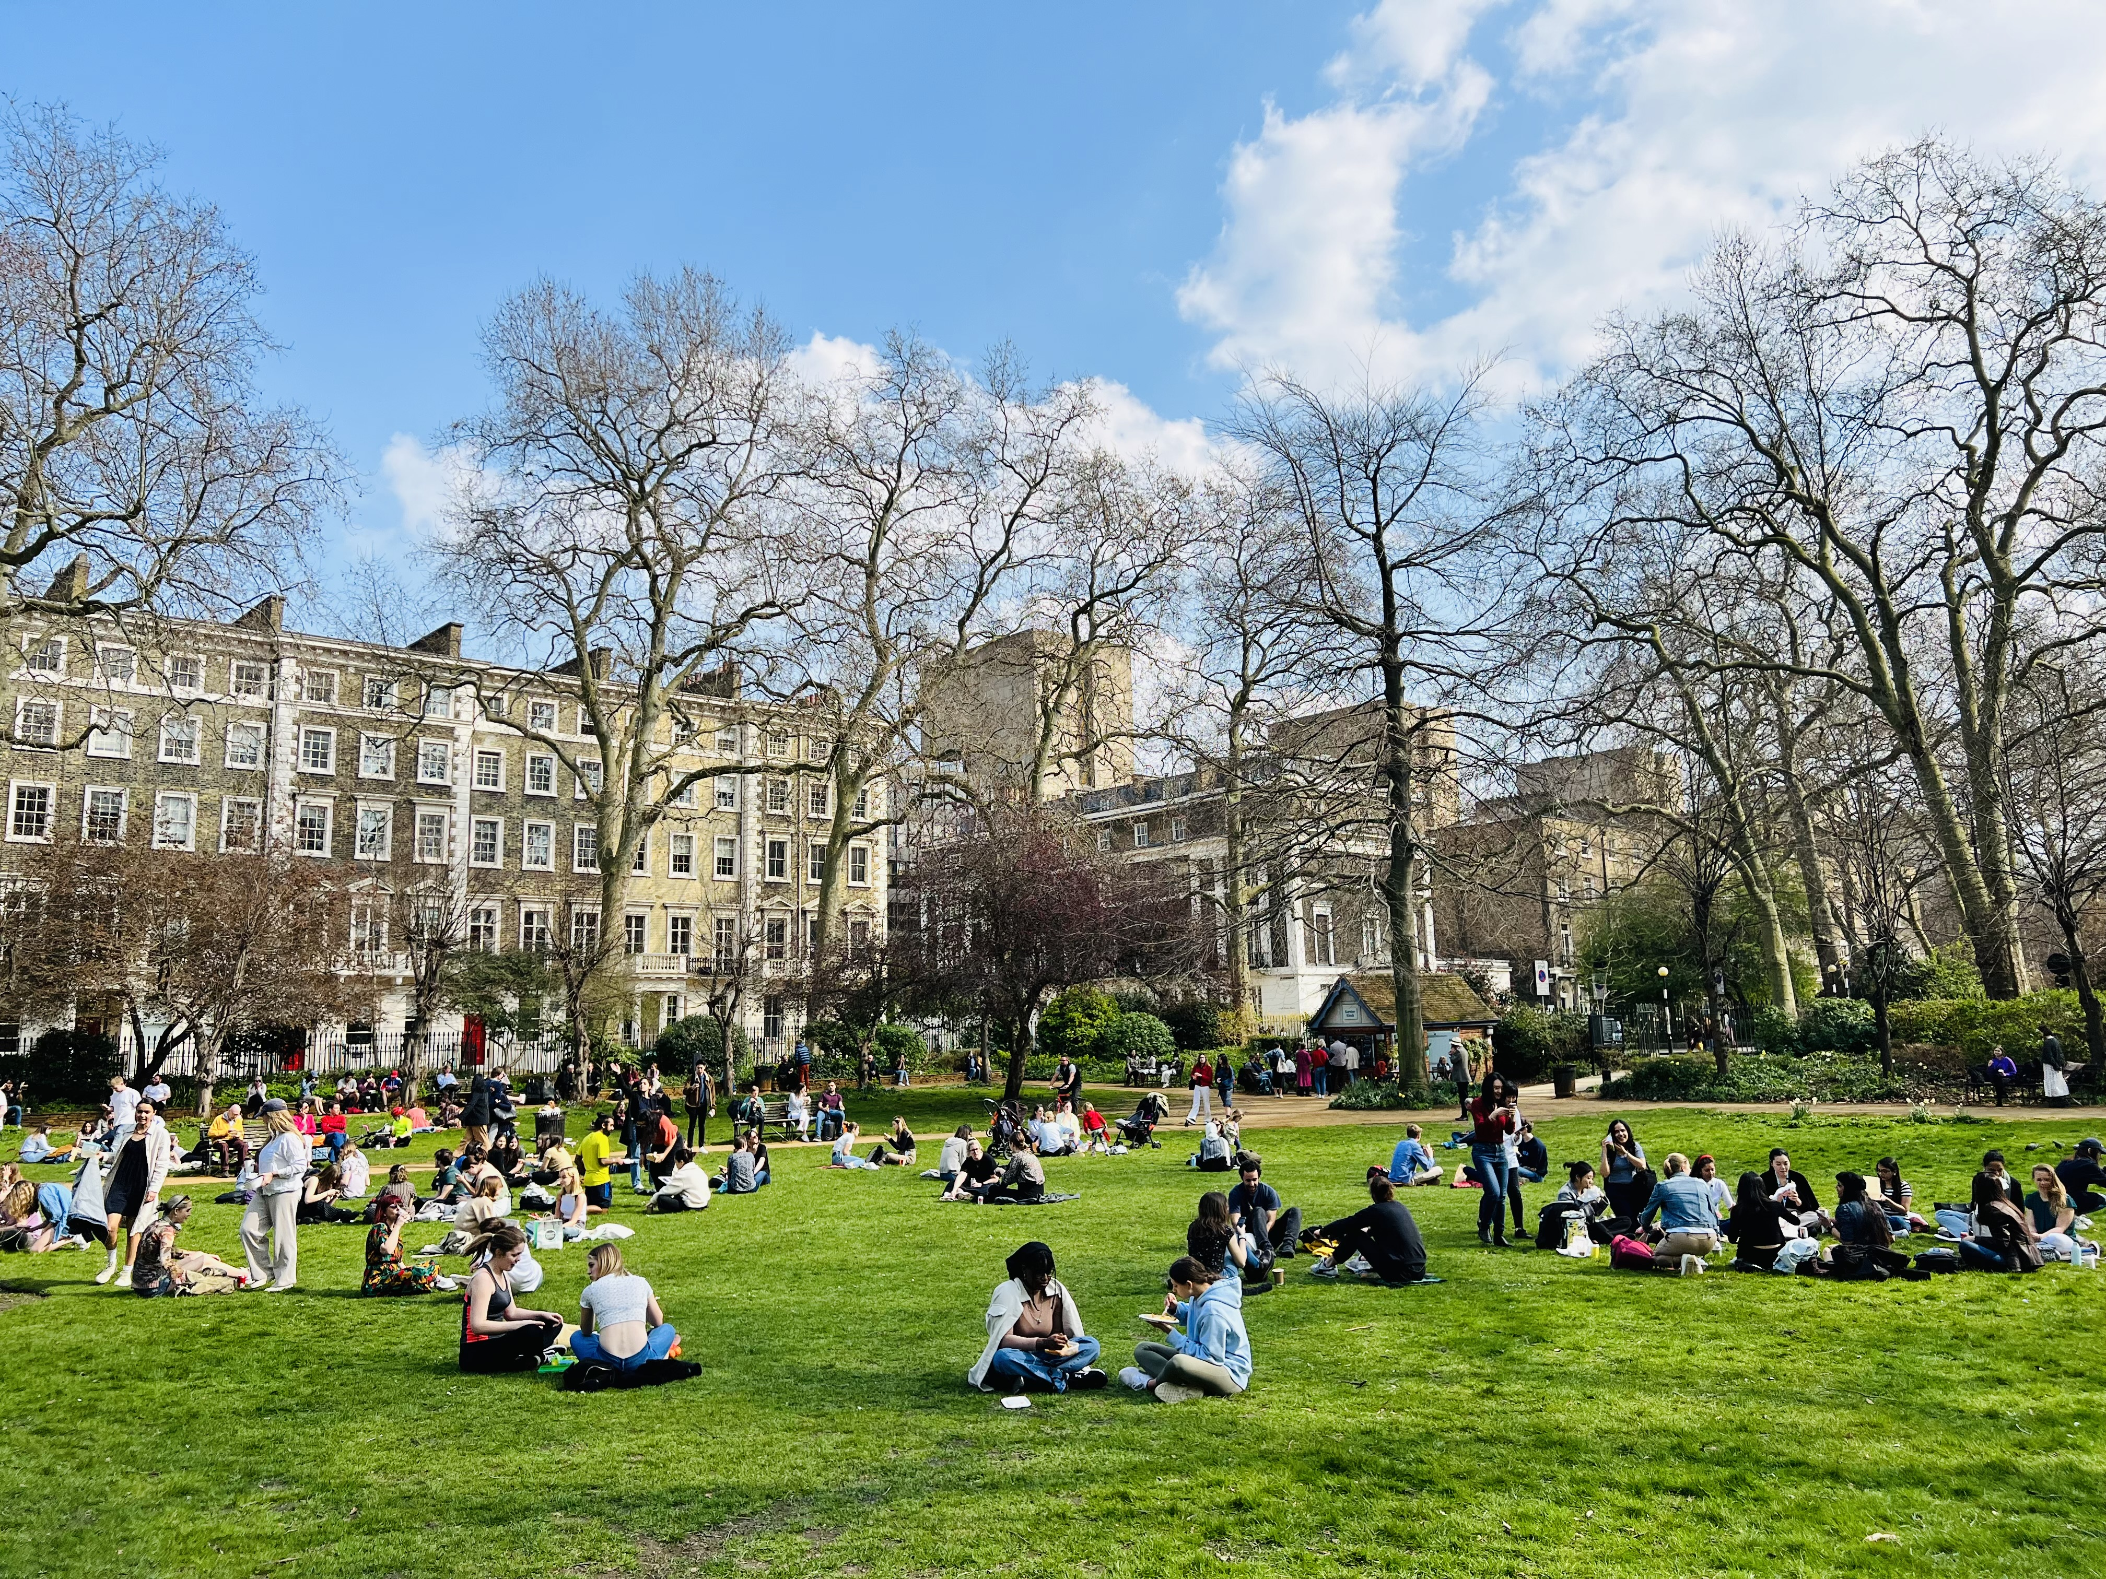
Multi-scale accessibility of greenspace and its equity in London based on two-step floating catchment area method
( 2SFCA)
Dissertation Proposal
MSc Smart City and Urban Analytics
Junqi Hu
Junqi Hu
2022.03.25

Slide 2
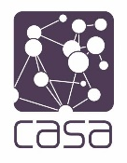
CONTENTS
1
Introduction
1
2
Methodology
3
Dataset
Research Objectives
4
References
5

Slide 3
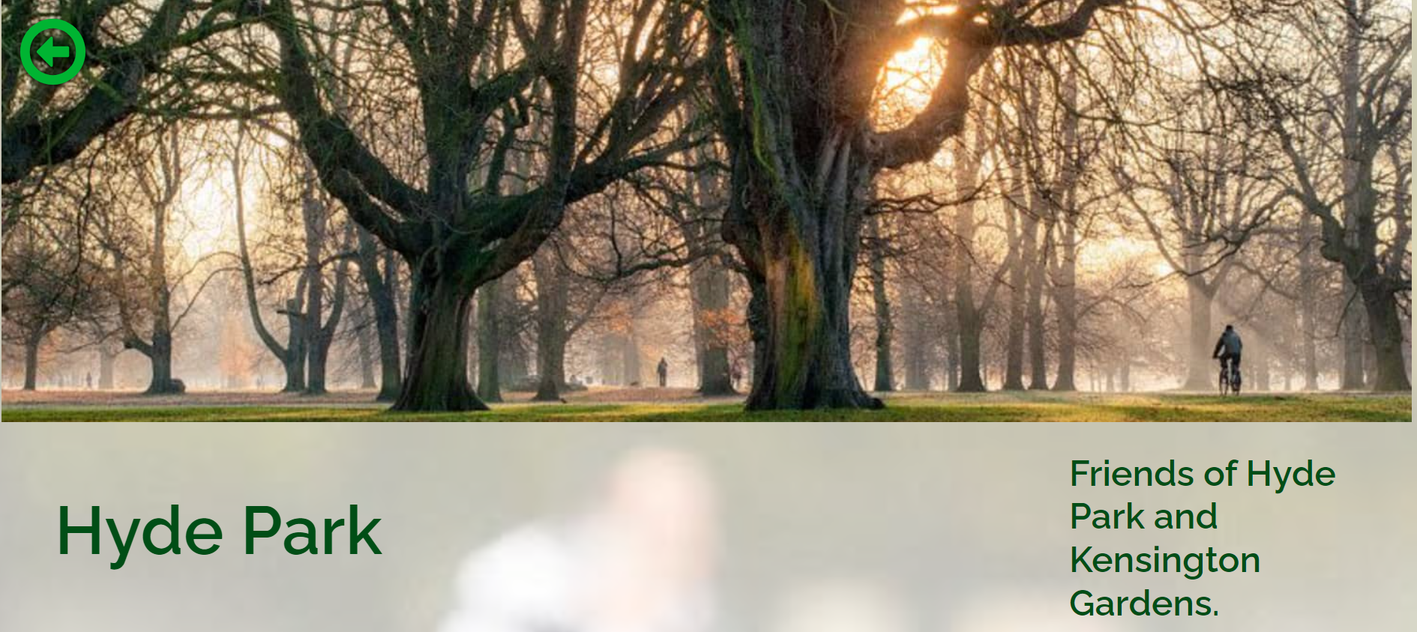
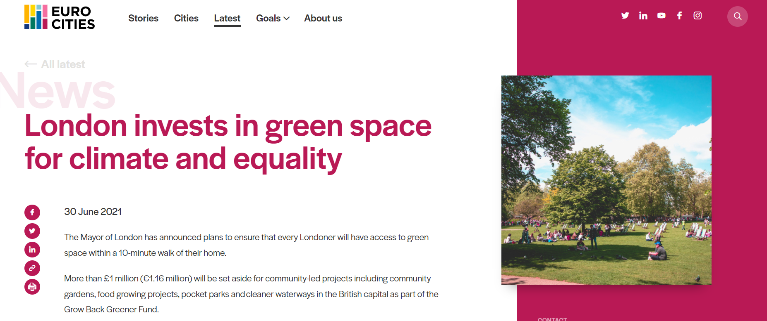
Introduction
Public parks and gardens are the most frequented form of green space in Britain's cities, contributing to people's wellbeing by providing opportunities to experience nature, engage in physical activity, feel a sense of social belonging and develop social interaction.
Greenspace accessibility and equity are important indicators to measure the accessibility and opportunities for urban residents to access and use green space, as well as to evaluate and reflect the scientific and rational spatial allocation of urban green space resources. There are few studies that have measured the accessibility and equity of green spaces from multiple scales and travel modes.
The choice of travel mode directly determines the accessibility of urban parks, and the accessibility of transport infrastructure also determines the range of activities of residents to a certain extent, affecting the rational allocation of urban park resources.
access to green space within a 10-minute walk of their home. -----------The Mayor of London

Slide 4
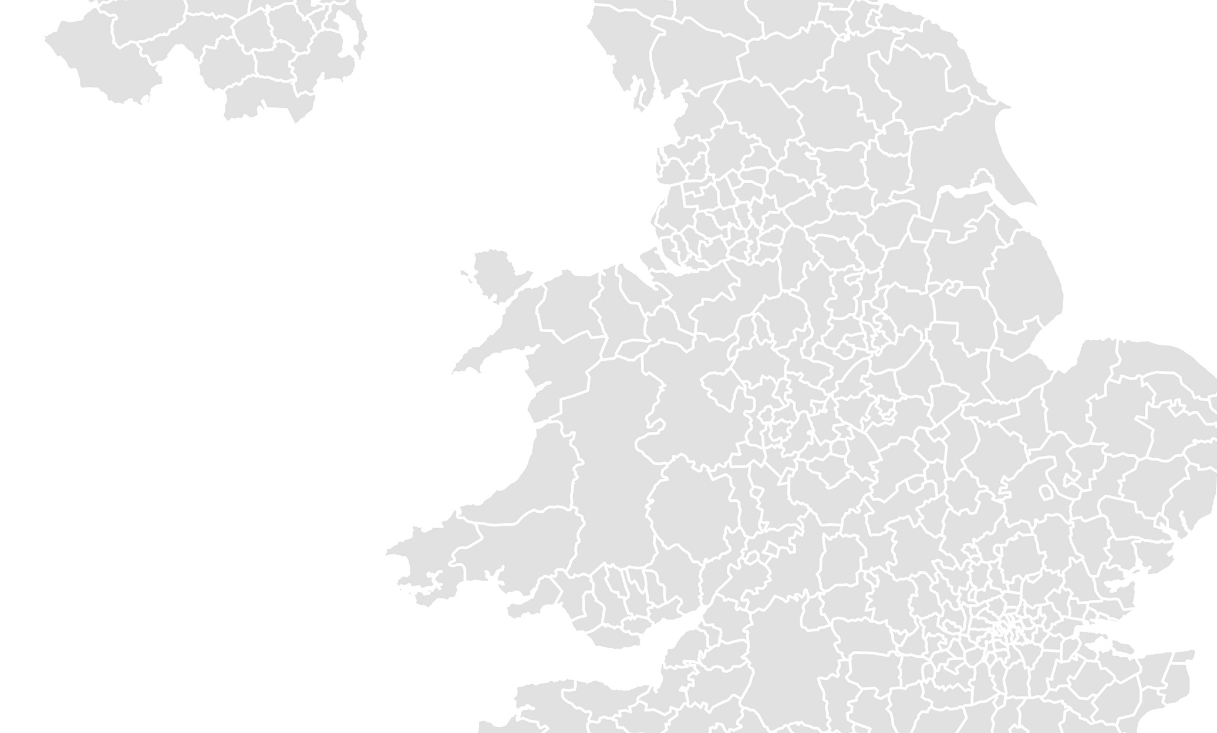
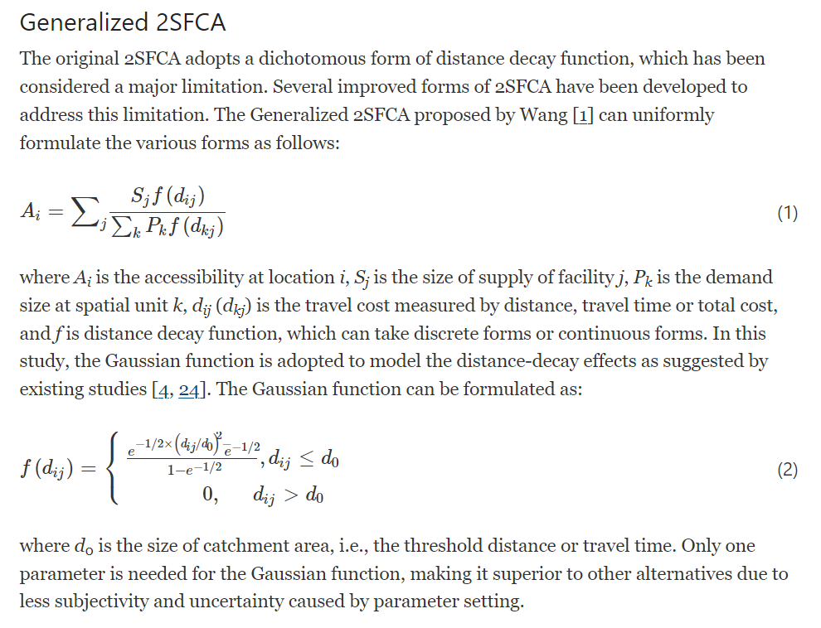
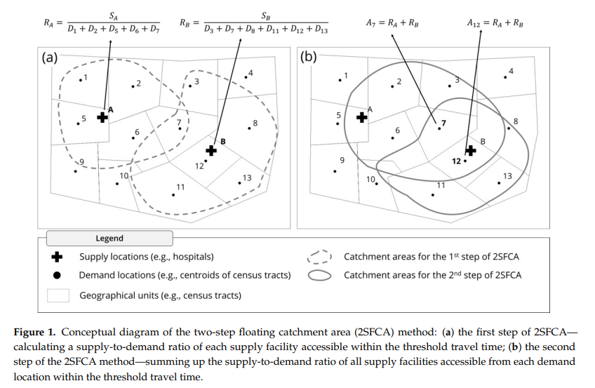
Methodology
Two-step floating catchment area method(2SFCA)
2SFCA, as a special form of the gravity model (i.e. the main type of SI model), argues that accessibility is mediated not only by distance decay (metastability in SI theory) but also by interactions between supply and demand ('complementarity'; Haynes and Fotheringham 1984).
Everything is related to everything else, but near things are more related than distant things (Tobler 1970).’ Tobler’sfirst law of geography has established the theoretical foundation of spatial interaction (SI) models in the analysis of spatial associations between geographic entities.
Access to greenspaces includes several modes of transport: walking, driving, bus and metro, etc. The 2SFCA two-step floating carrying area model was used to assess the accessibility of green spaces in the neighbourhood.
https://equityhealthj.biomedcentral.com/articles/10.1186/s12939-020-01280-7
https://www.mdpi.com/2220-9964/10/8/532

Slide 5
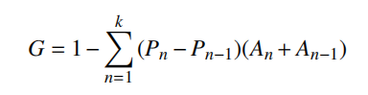
Methodology
The Gini & Lorenz curve
The Gini coefficient and Lorenz curve are widely used in the evaluation of the level of service of public resources.
The Gini coefficient and the Lorenz curve have a wide range of applications in the evaluation of the level of service of public resources.
The Gini coefficient and Lorenz curve analysis are often used as quantitative indicators for evaluating social equity performance. They were originally proposed by the American statistician Lorenz to explore the fairness of the distribution of income, and the distribution of income based on the connotation of social equity is similar in nature to the distribution of public resources.
In the field of transport science, the Gini coefficient and the Lorenz curve have been used to evaluate the level of distribution of transport.
Pn:the cumulative proportion of population variables at the settlement, n=1, 2,
3,...,
k:the number of districts,
A: the greenspace resource variable
The magnitude of the Gini coefficient reflects the equity of the allocation of urban greenspace resources under different transportation modes.

Slide 6
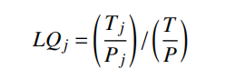
Methodology
Location Entropy
The location entropy indicates the park resources enjoyed by the population living in the unit to the urban park resources per inhabitant in the whole study area, which can be be used to express the spatial distribution of the fairness of the per capita distribution of resources in the study unit Distribution pattern
The theory of 'location entropy' is a very meaningful economic indicator proposed by Haggett to measure the spatial distribution of regional factors.
In economics and geography, locational entropy is used to measure the spatial pattern of resource allocation.
LQ_{j} : the location entropy of cell j
T_{j} : the area of urban park
P_{j} : the number of population in unit j,
T: the total area of urban park resources in the study area
P: the number of permanent residents in the study area.
Area entropy considers the spatial pattern of resource allocation in urban greenspaces under different travel patterns.

Slide 7
Dataset
The content of the dataset
 | content | name | source
1 | Population | MSOA/LSOA/OA population | ONS/London Datastore
 |  |  | https://data.london.gov.uk/dataset/super-output-area-population-lsoa-msoa-london
2 | Greenspace | GiGL Open Space Friends Group subset/ Open Street Map | London Datastore/OSM
 |  |  | https://data.london.gov.uk/dataset/gigl-open-space-friends-group-data-sub-set
3 | Road | gis_osm_roads | OSM
4 | Subway/Light Rail | gis_osm_railway | OSM
5 | London_Boundaries | Statistical GIS Boundary Files for London | London Datastore
 |  |  | https://data.london.gov.uk/dataset/statistical-gis-boundary-files-london

Slide 8
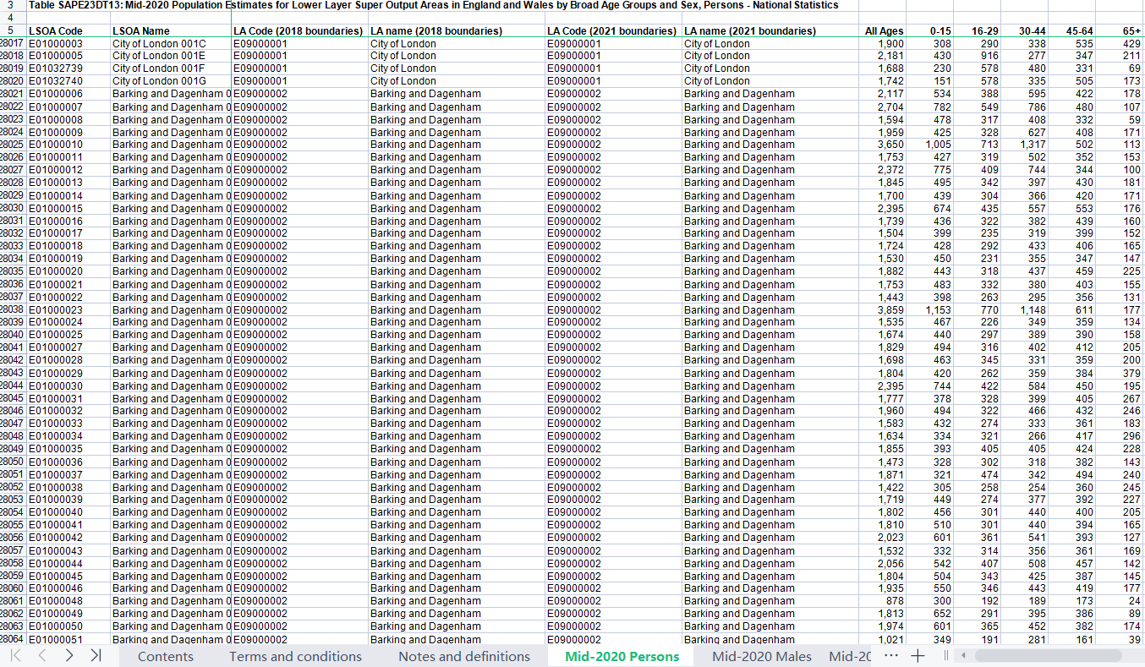
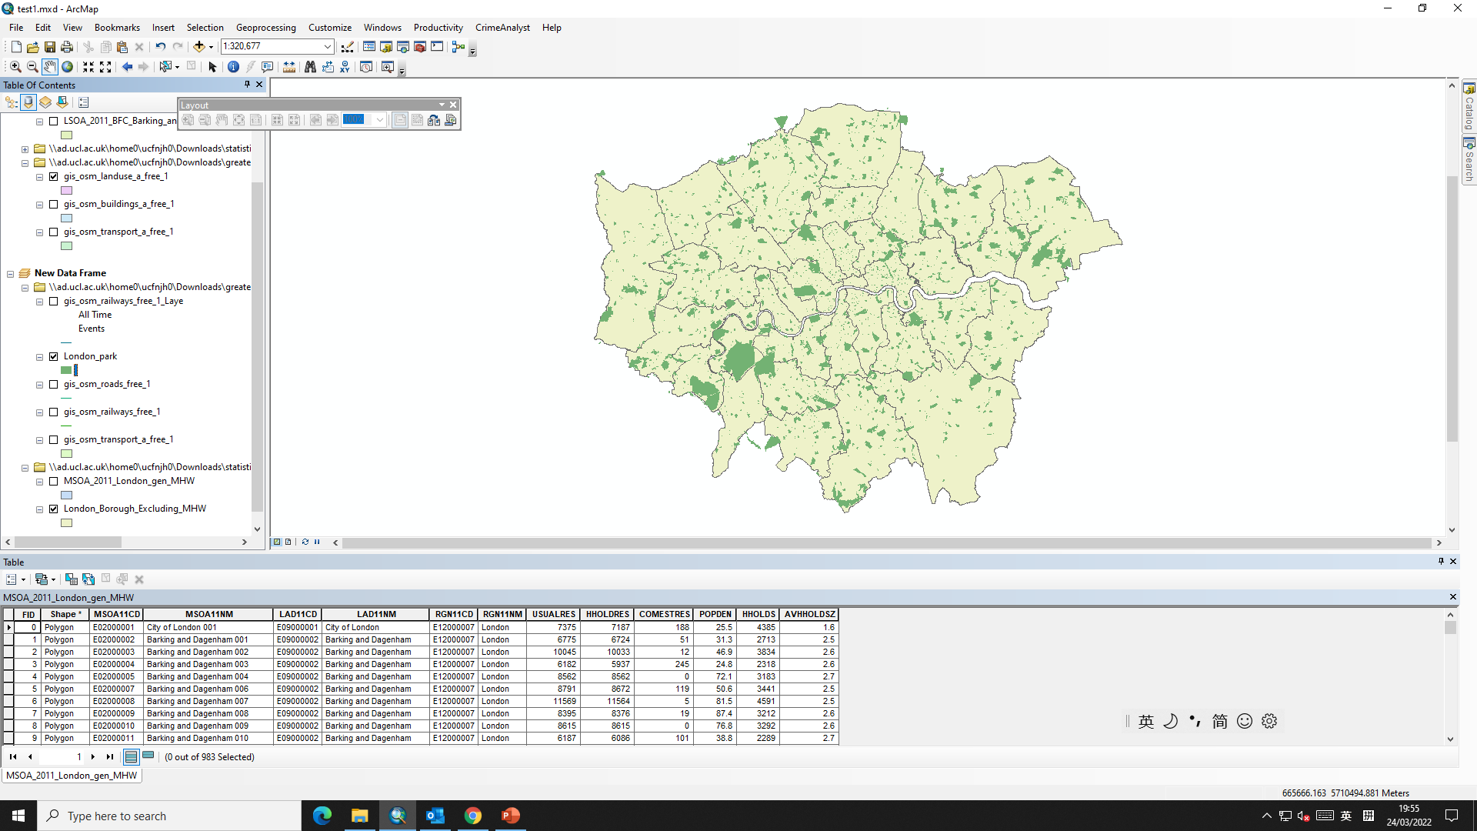
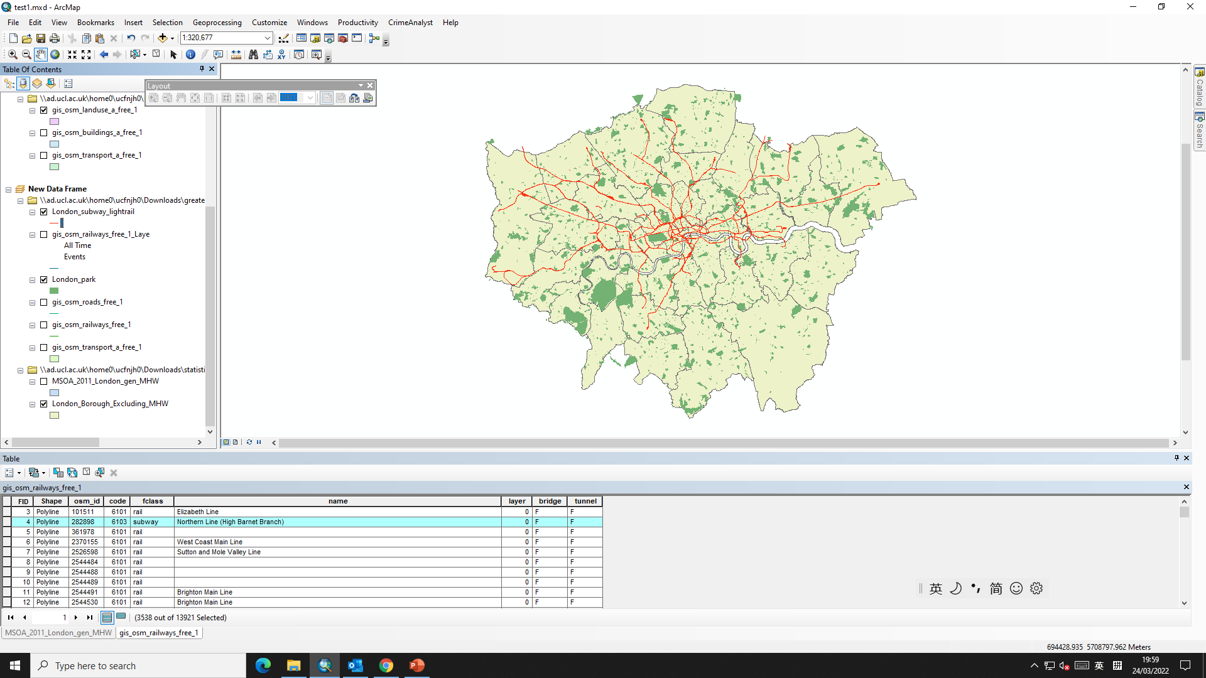
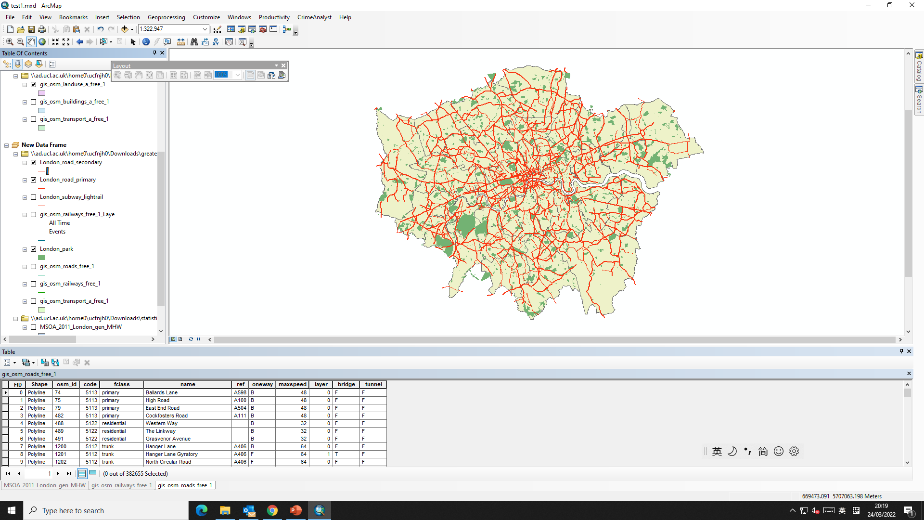
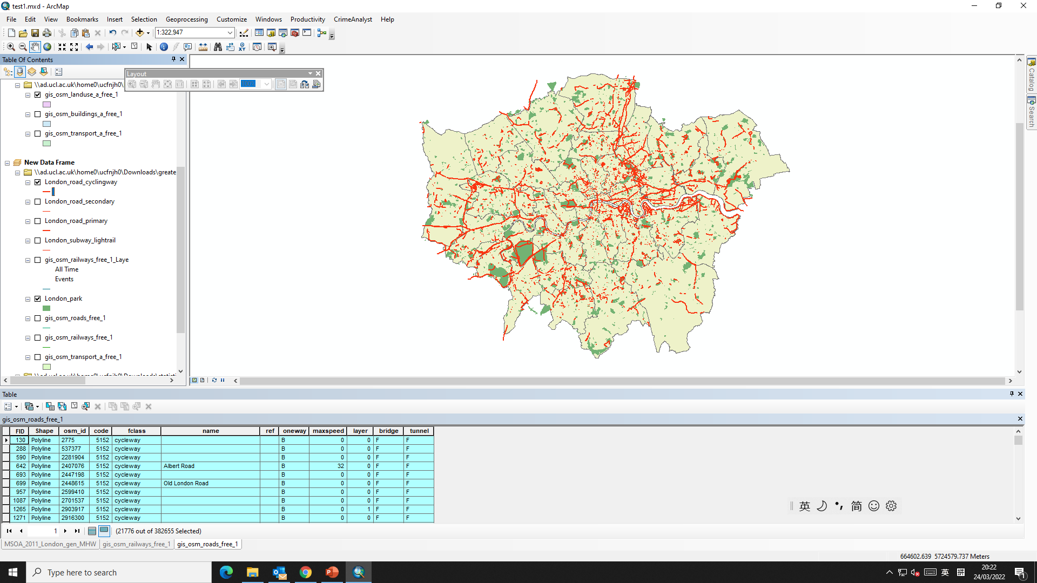
Dataset
Population
Greenspace
Subway&lightrail
Primary Road
Cyclyingway

Slide 9
Research Objectives
Hope to achieve:
Explore the accessibility of London greenspace under multi-transportation modes.
Explore the equity of the allocation of urban greenspace resources under different transportation modes.
Explore the spatial patterns of urban greenspace allocation under different travel modes.
Suggest for Urban greenspace planning and sustainable urbal development.

Slide 10
References
Cetin, M. (2015). Using GIS analysis to assess urban green space in terms of accessibility: Case study in Kutahya. International Journal of Sustainable Development and World Ecology, 22(5), 420–424. https://doi.org/10.1080/13504509.2015.1061066
Chen, C., & Xiu, C.-L. (2014). SPATIAL ACCESSIBILITY OF LARGE GENERAL HOSPITALS IN CHANGCHUN CITY SPATIAL ACCESSIBILITY OF LARGE GENERAL HOSPITALS IN CHANGCHUN CITY CENTER BASED ON STREET NETWORK CENTRALITY CENTER BASED ON STREET NETWORK CENTRALITY 人文地理. HUMAN GEOGRAPHY, 29(5), 29.
Chen, X., & Jia, P. (2019). A comparative analysis of accessibility measures by the two-step floating catchment area (2SFCA) method. International Journal of Geographical Information Science, 33(9), 1739–1758. https://doi.org/10.1080/13658816.2019.1591415
Geospatial, 地 理 空 间 信 息. (2019). 基于两步移动搜索法的公园绿地可达性研究 段松江. 17(8). https://doi.org/10.3969/j.issn.1672
Jang, S., An, Y., Yi, C., & Lee, S. (2017). Assessing the spatial equity of Seoul’s public transportation using the Gini coefficient based on its accessibility. International Journal of Urban Sciences, 21(1), 91–107. https://doi.org/10.1080/12265934.2016.1235487
Liu, D., Kwan, M. P., & Kan, Z. (2021). Analysis of urban green space accessibility and distribution inequity in the City of Chicago. Urban Forestry and Urban Greening, 59. https://doi.org/10.1016/j.ufug.2021.127029
Luo, W., & Qi, Y. (2009). An enhanced two-step floating catchment area (E2SFCA) method for measuring spatial accessibility to primary care physicians. Health and Place, 15(4), 1100–1107. https://doi.org/10.1016/j.healthplace.2009.06.002
Park, J., & Goldberg, D. W. (2021). A review of recent spatial accessibility studies that benefitted from advanced geospatial information: Multimodal transportation and spatiotemporal disaggregation. In ISPRS International Journal of Geo-Information (Vol. 10, Issue 8). MDPI AG. https://doi.org/10.3390/ijgi10080532
Taylor, L., & Hochuli, D. F. (2017). Defining greenspace: Multiple uses across multiple disciplines. Landscape and Urban Planning, 158, 25–38. https://doi.org/10.1016/j.landurbplan.2016.09.024
Yi, W., Chen, B., Jin-guang, Z., & Bing, Z. (2020). Spatial Equity of Urban Parks in the Central Urban Area in Nanjing Based on Different Transportations. Journal of Beijing Forestry University (Social Sciences, 19(2). https://doi.org/10.13931/j.cnki.bjfuss.2019166
Yin, H., & Kong, F. (2008). Accessibility and equity assessment on urban green space Research on the Cooling effect of Urban green spaces based on multi-source data and WRF model View project Multi-scale Stormwater management based on GI View project. https://www.researchgate.net/publication/287911676
Zhang, X., Lu, H., & Holt, J. B. (2011). Modeling spatial accessibility to parks: A national study. International Journal of Health Geographics, 10. https://doi.org/10.1186/1476-072X-10-31
许基伟, 方世明, 刘春燕, Jiwei, X., Shiming, F., & Chunyan, L. (2017). 基于G2SFCA的武汉市中心城区公园绿地空间公平性分析. 资源科学, 39(3), 430–440. https://doi.org/10.18402/resci.2017.03.05

Slide 11
Thank you！

